Slide 1
Guide to Computer Forensics and Investigations
Fourth Edition
Chapter 2
Understanding Computer Investigations

Slide 2
Objectives
Explain how to prepare a computer investigation
Apply a systematic approach to an investigation
Describe procedures for corporate high-tech investigations
Explain requirements for data recovery workstations and software
Describe how to conduct an investigation
Explain how to complete and critique a case

Slide 3
Preparing a Computer Investigation

Slide 4
Preparing a Computer Investigation
Role of computer forensics professional is to gather evidence to prove that a suspect committed a crime or violated a company policy
Collect evidence that can be offered in court or at a corporate inquiry
  Investigate the suspect’s computer
  Preserve the evidence on a different computer

Slide 5
Preparing a Computer Investigation
(continued)
Follow an accepted procedure to prepare a case
Chain of custody
  Route the evidence takes from the time you find it until the case is closed or goes to court

Slide 6
An Overview of a Computer Crime
Computers can contain information that helps law enforcement determine:
  Chain of events leading to a crime
  Evidence that can lead to a conviction
Law enforcement officers should follow proper procedure when acquiring the evidence
  Digital evidence can be easily altered by an overeager investigator
Information on hard disks might be password protected

Slide 7
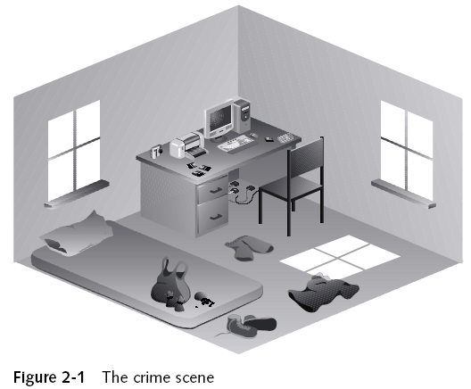
Examining a Computer Crime

Slide 8
An Overview of a Company Policy Violation
Employees misusing resources can cost companies millions of dollars
Misuse includes:
  Surfing the Internet
  Sending personal e-mails
  Using company computers for personal tasks

Slide 9
Taking a Systematic Approach

Slide 10
Taking a Systematic Approach
Steps for problem solving
  Make an initial assessment about the type of case you are investigating
  Determine a preliminary design or approach to the case
  Create a detailed checklist
  Determine the resources you need
  Obtain and copy an evidence disk drive

Slide 11
Taking a Systematic Approach
(continued)
Steps for problem solving (continued)
  Identify the risks
  Mitigate or minimize the risks
  Test the design
  Analyze and recover the digital evidence
  Investigate the data you recover
  Complete the case report
  Critique the case

Slide 12
Assessing the Case
Systematically outline the case details
  Situation
  Nature of the case
  Specifics of the case
  Type of evidence
  Operating system
  Known disk format
  Location of evidence

Slide 13
Assessing the Case (continued)
Based on case details, you can determine the case requirements
  Type of evidence
  Computer forensics tools
  Special operating systems

Slide 14
Planning Your Investigation
A basic investigation plan should include the following activities:
  Acquire the evidence
  Complete an evidence form and establish a chain of custody
  Transport the evidence to a computer forensics lab
  Secure evidence in an approved secure container

Slide 15
Planning Your Investigation
(continued)
A basic investigation plan (continued):
  Prepare a forensics workstation
  Obtain the evidence from the secure container
  Make a forensic copy of the evidence
  Return the evidence to the secure container
  Process the copied evidence with computer forensics tools

Slide 16
Planning Your Investigation
(continued)
An evidence custody form helps you document what has been done with the original evidence and its forensics copies
Two types
  Single-evidence form
    Lists each piece of evidence on a separate page
  Multi-evidence form

Slide 17
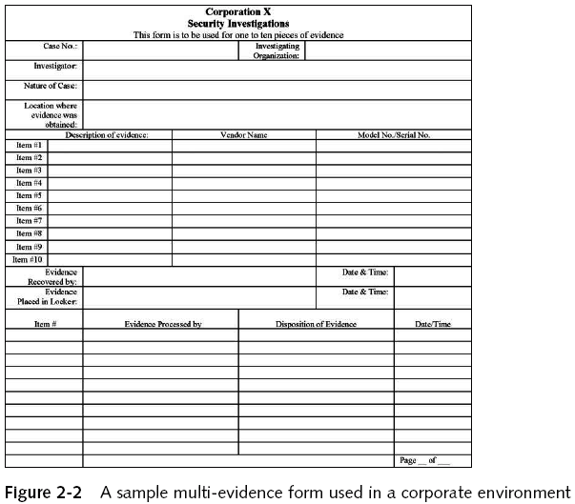
Planning Your Investigation
(continued)

Slide 18
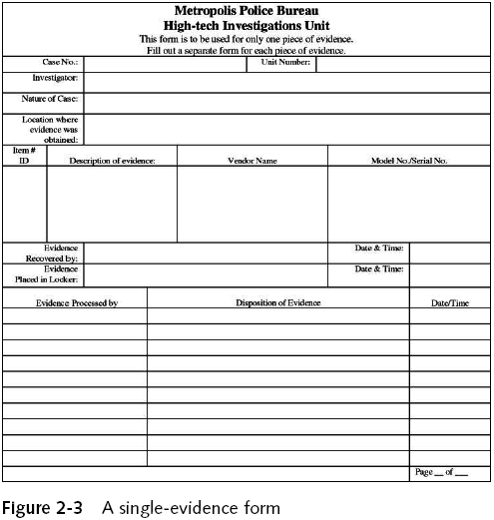
Planning Your Investigation
(continued)

Slide 19
Securing Your Evidence
Use evidence bags to secure and catalog the evidence
Use computer safe products
  Antistatic bags
  Antistatic pads
Use well padded containers
Use evidence tape to seal all openings
  Floppy disk or CD drives
  Power supply electrical cord

Slide 20
Securing Your Evidence (continued)
Write your initials on tape to prove that evidence has not been tampered with
Consider computer specific temperature and humidity ranges

Slide 21
Procedures for Corporate High-Tech Investigations

Slide 22
Procedures for Corporate High-Tech Investigations
Develop formal procedures and informal checklists
  To cover all issues important to high-tech investigations

Slide 23
Employee Termination Cases
Majority of investigative work for termination cases involves employee abuse of corporate assets
Internet abuse investigations
  To conduct an investigation you need:
    Organization’s Internet proxy server logs
    Suspect computer’s IP address
    Suspect computer’s disk drive
    Your preferred computer forensics analysis tool

Slide 24
Employee Termination Cases (continued)
Internet abuse investigations (continued)
  Recommended steps
    Use standard forensic analysis techniques and procedures
    Use appropriate tools to extract all Web page URL information
    Contact the network firewall administrator and request a proxy server log
    Compare the data recovered from forensic analysis to the proxy server log
    Continue analyzing the computer’s disk drive data

Slide 25
Employee Termination Cases (continued)
E-mail abuse investigations
  To conduct an investigation you need:
    An electronic copy of the offending e-mail that contains message header data
    If available, e-mail server log records
    For e-mail systems that store users’ messages on a central server, access to the server
    Access to the computer so that you can perform a forensic analysis on it
    Your preferred computer forensics analysis tool

Slide 26
Employee Termination Cases (continued)
E-mail abuse investigations (continued)
  Recommended steps
    Use the standard forensic analysis techniques
    Obtain an electronic copy of the suspect’s and victim’s e-mail folder or data
    For Web-based e-mail investigations, use tools such as FTK’s Internet Keyword Search option to extract all related e-mail address information
    Examine header data of all messages of interest to the investigation

Slide 27
Attorney-Client Privilege Investigations
Under attorney-client privilege (ACP) rules for an attorney
  You must keep all findings confidential
Many attorneys like to have printouts of the data you have recovered
  You need to persuade and educate many attorneys on how digital evidence can be viewed electronically
You can also encounter problems if you find data in the form of binary files

Slide 28
Attorney-Client Privilege Investigations (continued)
Steps for conducting an ACP case
  Request a memorandum from the attorney directing you to start the investigation
  Request a list of keywords of interest to the investigation
  Initiate the investigation and analysis
  For disk drive examinations, make two bit-stream images using different tools
  Compare hash signatures on all files on the original and re-created disks

Slide 29
Attorney-Client Privilege Investigations (continued)
Steps for conducting an ACP case (continued)
  Methodically examine every portion of the disk drive and extract all data
  Run keyword searches on allocated and unallocated disk space
  For Windows OSs, use specialty tools to analyze and extract data from the Registry
    AccessData Registry Viewer
  For binary data files such as CAD drawings, locate the correct software product
  For unallocated data recovery, use a tool that removes or replaces nonprintable data

Slide 30
Attorney-Client Privilege Investigations (continued)
Steps for conducting an ACP case (continued)
  Consolidate all recovered data from the evidence bit-stream image into folders and subfolders
Other guidelines
  Minimize written communications with the attorney
  Any documentation written to the attorney must contain a header stating that it’s “Privileged Legal Communication—Confidential Work Product”

Slide 31
Attorney-Client Privilege Investigations (continued)
Other guidelines (continued)
  Assist attorney and paralegal in analyzing the data
If you have difficulty complying with the directions
  Contact the attorney and explain the problem
Always keep an open line of verbal communication
If you’re communicating via e-mail, use encryption

Slide 32
Media Leak Investigations
In the corporate environment, controlling sensitive data can be difficult
Consider the following for media leak investigations
  Examine e-mail
  Examine Internet message boards
  Examine proxy server logs
  Examine known suspects’ workstations
  Examine all company telephone records, looking for calls to the media

Slide 33
Media Leak Investigations (consider)
Steps to take for media leaks
  Interview management privately
    To get a list of employees who have direct knowledge of the sensitive data
  Identify media source that published the information
  Review company phone records
  Obtain a list of keywords related to the media leak
  Perform keyword searches on proxy and e-mail servers

Slide 34
Media Leak Investigations (consider)
Steps to take for media leaks (continued)
  Discreetly conduct forensic disk acquisitions and analysis
  From the forensic disk examinations, analyze all e-mail correspondence
    And trace any sensitive messages to other people
  Expand the discreet forensic disk acquisition and analysis
  Consolidate and review your findings periodically
  Routinely report findings to management

Slide 35
Industrial Espionage Investigations
All suspected industrial espionage cases should be treated as criminal investigations
Staff needed
  Computing investigator who is responsible for disk forensic examinations
  Technology specialist who is knowledgeable of the suspected compromised technical data
  Network specialist who can perform log analysis and set up network sniffers
  Threat assessment specialist (typically an attorney)

Slide 36
Industrial Espionage Investigations (continued)
Guidelines
  Determine whether this investigation involves a possible industrial espionage incident
  Consult with corporate attorneys and upper management
  Determine what information is needed to substantiate the allegation
  Generate a list of keywords for disk forensics and sniffer monitoring
  List and collect resources for the investigation

Slide 37
Industrial Espionage Investigations (continued)
Guidelines (continued)
  Determine goal and scope of the investigation
  Initiate investigation after approval from management
Planning considerations
  Examine all e-mail of suspected employees
  Search Internet newsgroups or message boards
  Initiate physical surveillance
  Examine facility physical access logs for sensitive areas

Slide 38
Industrial Espionage Investigations (continued)
Planning considerations (continued)
  Determine suspect location in relation to the vulnerable asset
  Study the suspect’s work habits
  Collect all incoming and outgoing phone logs
Steps
  Gather all personnel assigned to the investigation and brief them on the plan
  Gather resources to conduct the investigation

Slide 39
Industrial Espionage Investigations (continued)
Steps (continued)
  Place surveillance systems
  Discreetly gather any additional evidence
  Collect all log data from networks and e-mail servers
  Report regularly to management and corporate attorneys
  Review the investigation’s scope with management and corporate attorneys

Slide 40
Interviews and Interrogations in High-Tech Investigations
Becoming a skilled interviewer and interrogator can take many years of experience
Interview
  Usually conducted to collect information from a witness or suspect
    About specific facts related to an investigation
Interrogation
  Trying to get a suspect to confess

Slide 41
Interviews and Interrogations in High-Tech Investigations (continued)
Role as a computing investigator
  To instruct the investigator conducting the interview on what questions to ask
    And what the answers should be
Ingredients for a successful interview or interrogation
  Being patient throughout the session
  Repeating or rephrasing questions to zero in on specific facts from a reluctant witness or suspect
  Being tenacious

Slide 42
Understanding Data Recovery Workstations and Software

Slide 43
Understanding Data Recovery Workstations and Software
Investigations are conducted on a computer forensics lab (or data-recovery lab)
Computer forensics and data-recovery are related but different
Computer forensics workstation
  Specially configured personal computer
  Loaded with additional bays and forensics software
To avoid altering the evidence use:
  Forensics boot floppy disk OR cd
  Write-blocker devices

Slide 44
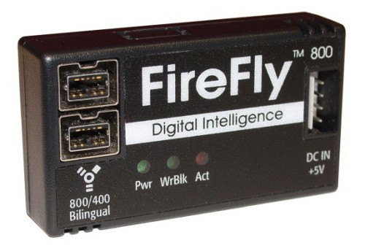
Write Blocker
Connects a hard drive in trusted read-only mode
There are also Linux boot CDs that mount all drives read-only, such as Helix and some Knoppix distributions

Slide 45
Setting Up your Computer for Computer Forensics
Basic requirements
  A workstation running Windows XP or Vista
  A write-blocker device
  Computer forensics acquisition tool
    Like FTK Imager
  Computer forensics analysis tool
    Like FTK
  Target drive to receive the source or suspect disk data
  Spare PATA or SATA ports
  USB ports

Slide 46
Setting Up your Computer for Computer Forensics (continued)
Additional useful items
  Network interface card (NIC)
  Extra USB ports
  FireWire 400/800 ports
  SCSI card
  Disk editor tool
  Text editor tool
  Graphics viewer program
  Other specialized viewing tools

Slide 47
Conducting an Investigation

Slide 48
Conducting an Investigation
Gather resources identified in investigation plan
Items needed
  Original storage media
  Evidence custody form
  Evidence container for the storage media
  Bit-stream imaging tool
  Forensic workstation to copy and examine your evidence
  Securable evidence locker, cabinet, or safe

Slide 49
Gathering the Evidence
Avoid damaging the evidence
Steps
  Meet the IT manager to interview him
  Fill out the evidence form, have the IT manager sign
  Place the evidence in a secure container
  Complete the evidence custody form
  Carry the evidence to the computer forensics lab
  Create forensics copies (if possible)
  Secure evidence by locking the container

Slide 50
Understanding Bit-Stream Copies
Bit-stream copy
  Bit-by-bit copy of the original storage medium
  Exact copy of the original disk
  Different from a simple backup copy
    Backup software only copies known files (active data)
    Backup software cannot copy deleted files, e-mail messages or recover file fragments
Bit-stream image
  File containing the bit-stream copy of all data on a disk or partition
  Also known as forensic copy

Slide 51
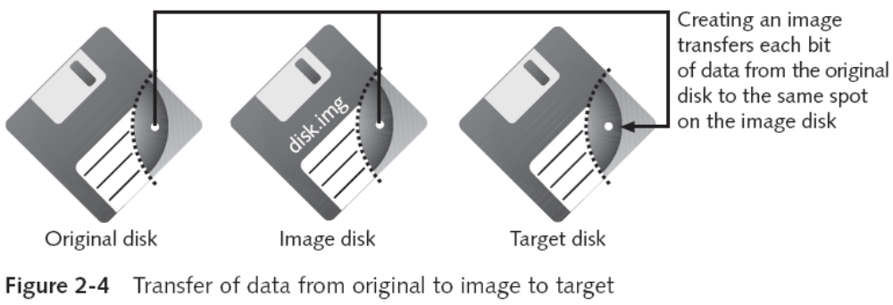
Understanding Bit-stream Copies (continued)
Copy image file to a target disk that matches the original disk’s manufacturer, size and model

Slide 52
Acquiring an Image of Evidence Media
First rule of computer forensics
  Preserve the original evidence
Conduct your analysis only on a copy of the data
We’ll skip the ProDiscover section of the textbook, which is on pages 48-58

Slide 53
Completing the Case

Slide 54
Completing the Case
You need to produce a final report
  State what you did and what you found
Include report generated by your forensic tool to document your work
Repeatable findings
  Repeat the steps and produce the same result, using different tools
If required, use a report template
Report should show conclusive evidence
  Suspect did or did not commit a crime or violate a company policy

Slide 55
Critiquing the Case
Ask yourself the following questions:
  How could you improve your performance in the case?
  Did you expect the results you found? Did the case develop in ways you did not expect?
  Was the documentation as thorough as it could have been?
  What feedback has been received from the requesting source?

Slide 56
Critiquing the Case (continued)
Ask yourself the following questions (continued):
  Did you discover any new problems? If so, what are they?
  Did you use new techniques during the case or during research?

